Slide 1

Predictive Analysis Approach for Heart Disease Prediction using various Machine Learning Algorithm
BY
KEERTHI K
DHARANI K
BOOPATHI RAJA
VIGNESH S
GOPALA KRISHANA
PROJECT PRESENTATION

Slide 2
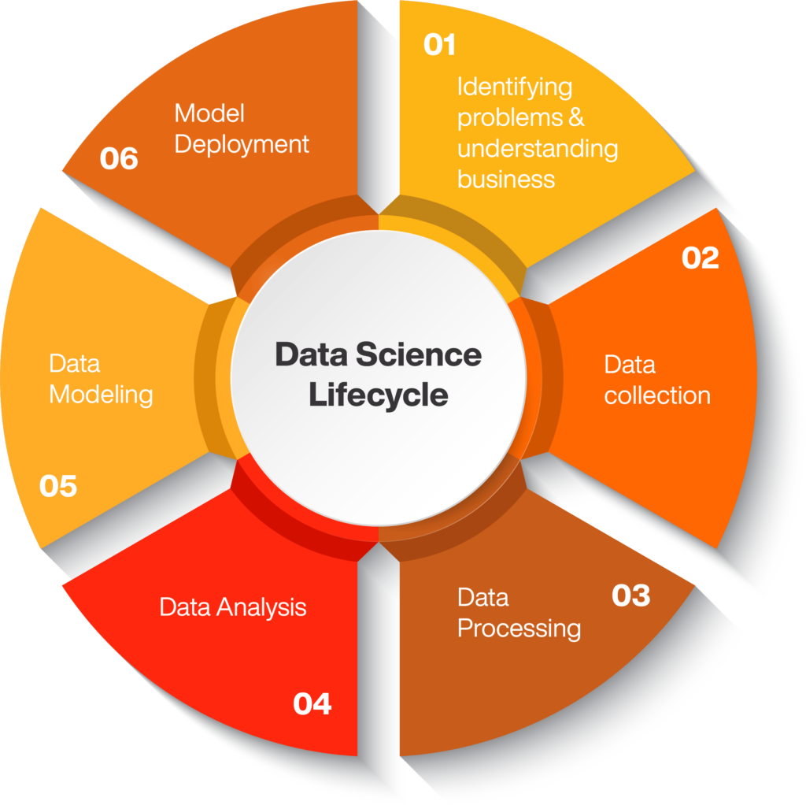

Slide 3
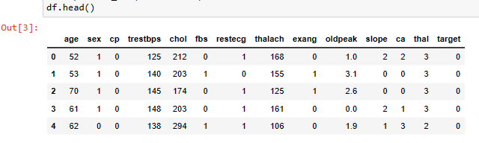
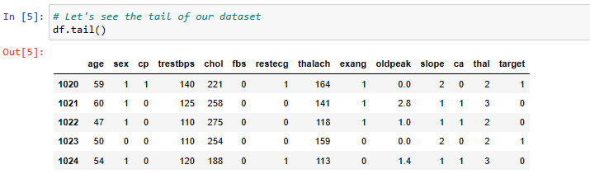
PROBLEM STATEMENT
DATA MINING

Slide 4
EXISTING SYSTEM AND OBJECTIVE OF OUR PROJECT
According to World Health Organization (WHO), the greatest number of deaths in middle aged people are due to Cardiovascular diseases
A quiet Significant amount of work related to the diagnosis of Cardiovascular Heart disease using Machine Learning algorithms has motivated this work
Machine Learning and Neural Networks approach.
Age, chol, Average Glucose Level for Predicting
The goal of this project is to develop a machine learning algorithm that can predict the likelihood of heart disease in individuals based on their clinical and demographic characteristics. The algorithm will take into account various input features such as age, gender, blood pressure, cholesterol levels, family history, and lifestyle factors (e.g., smoking, physical activity) to generate accurate predictions

Slide 5
PROBLEM SOLUTION
Machine Learning Algorithms
In this project, we attempt to bridge the gap by providing a systematic analysis of the various patient records for the purpose of Heart disease prediction

Slide 6
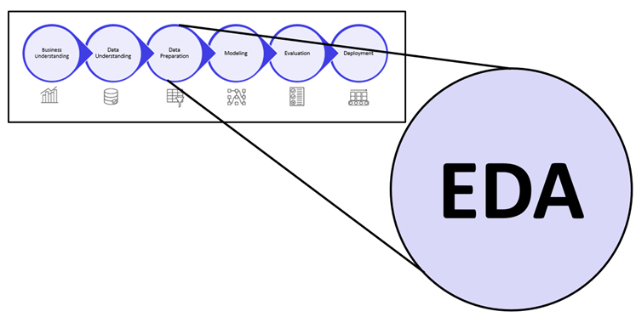
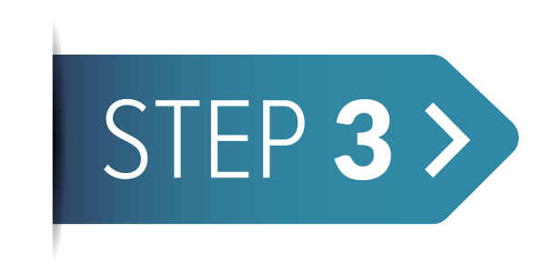

Slide 7
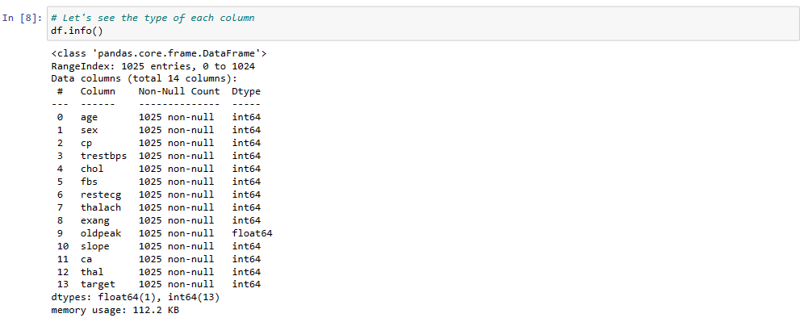
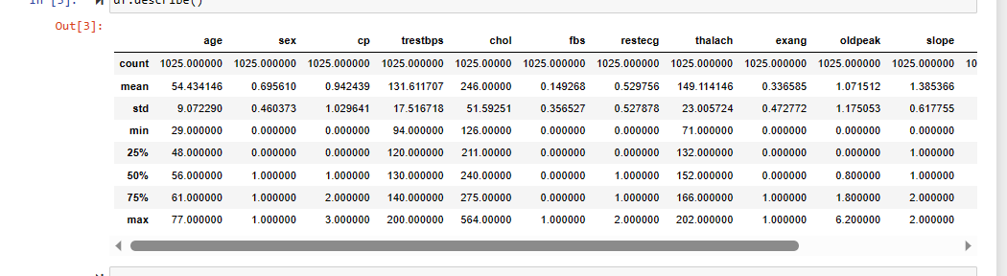
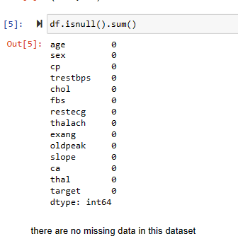
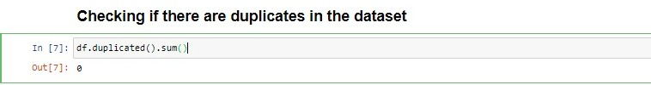
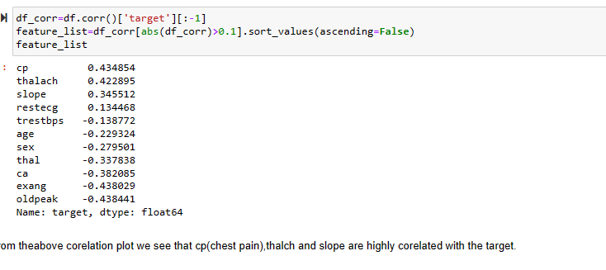
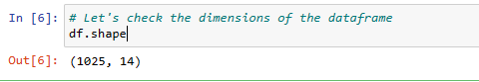
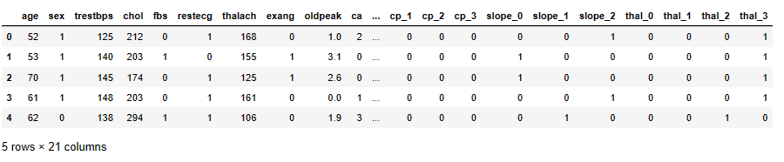

Slide 8
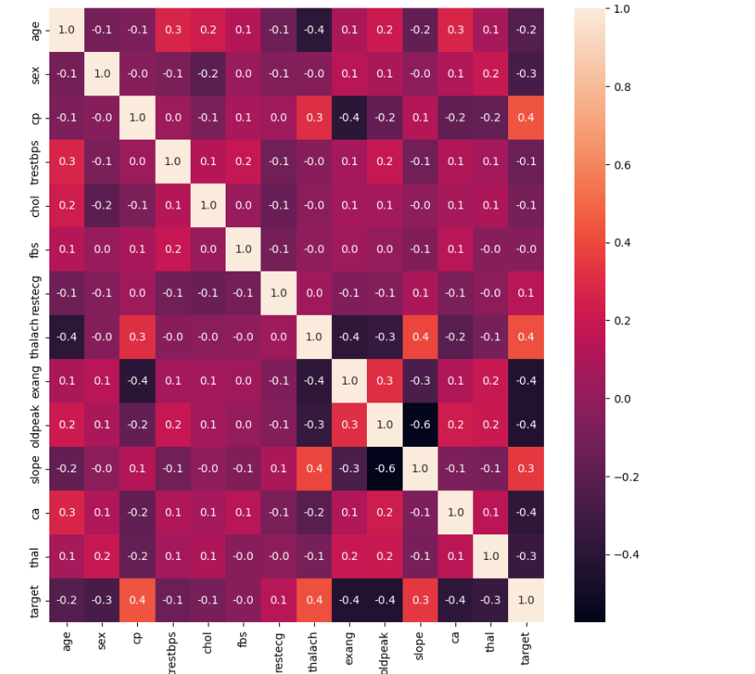
from this correlation plot we see that cp(chest pain),thalch and slope are highly corelated with the target.

Slide 9



Slide 10
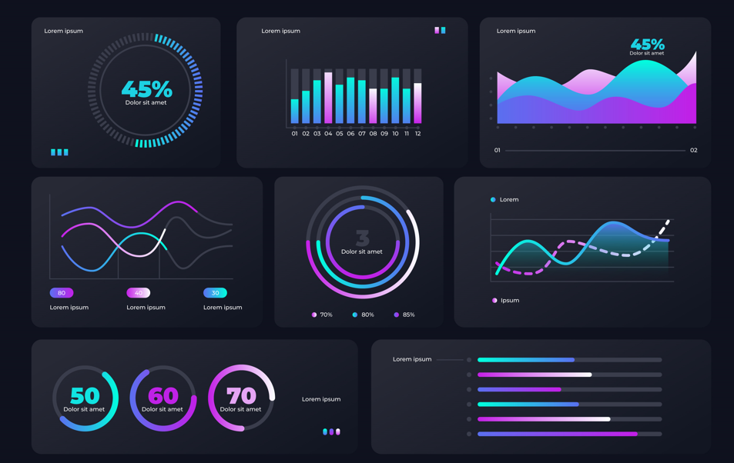

Slide 11


Slide 12
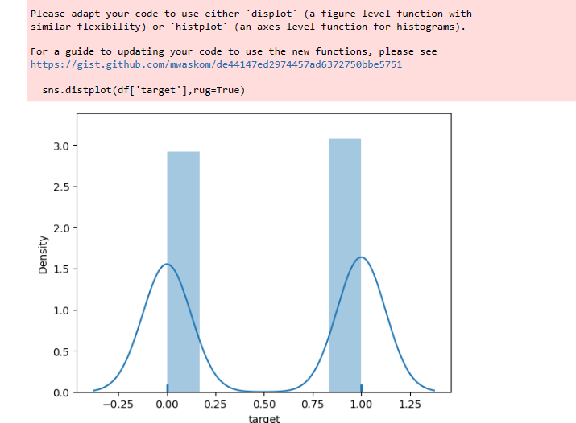
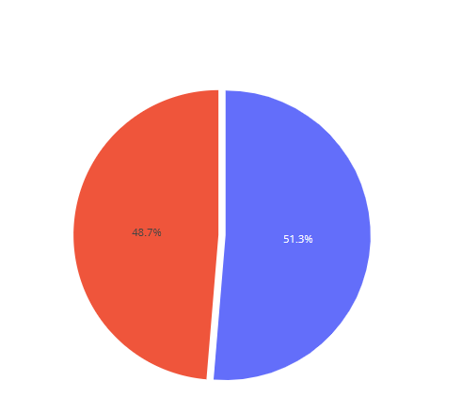
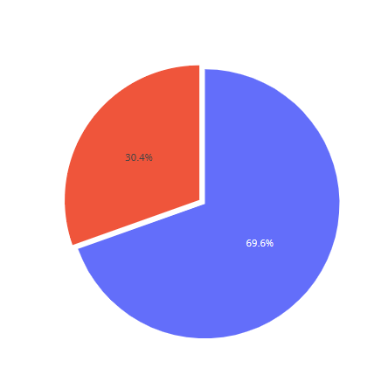
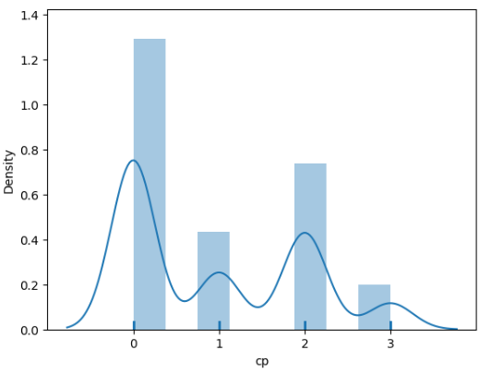
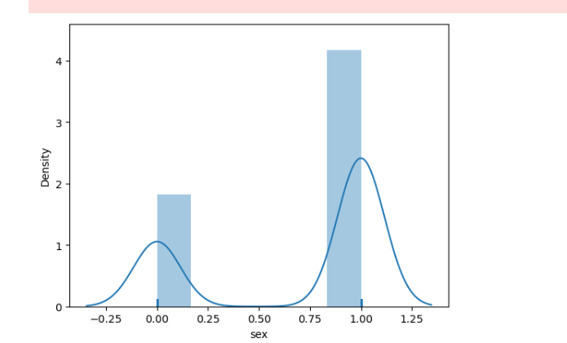
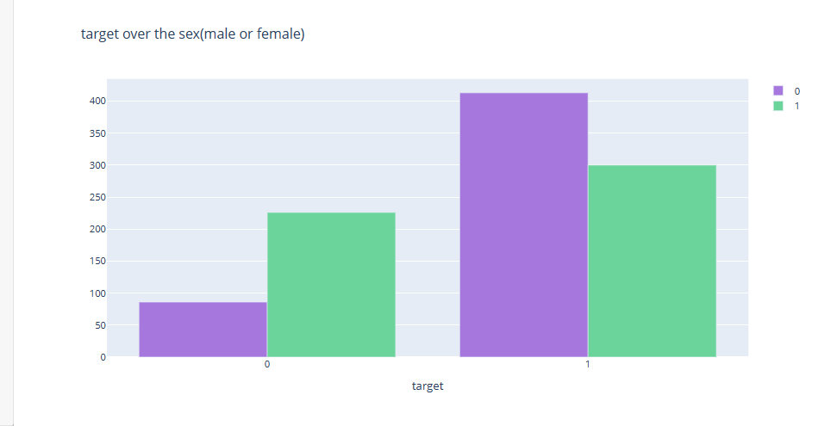
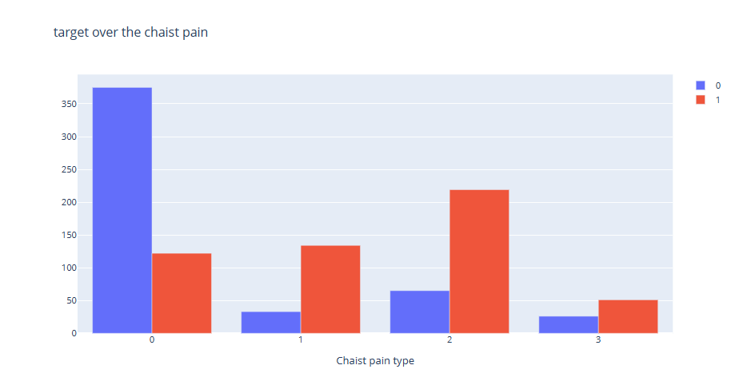

Slide 13
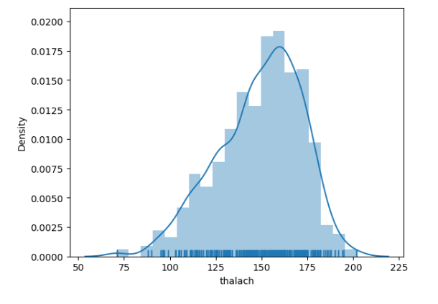
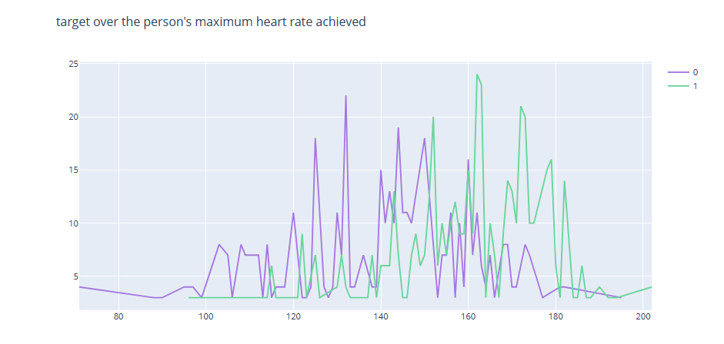
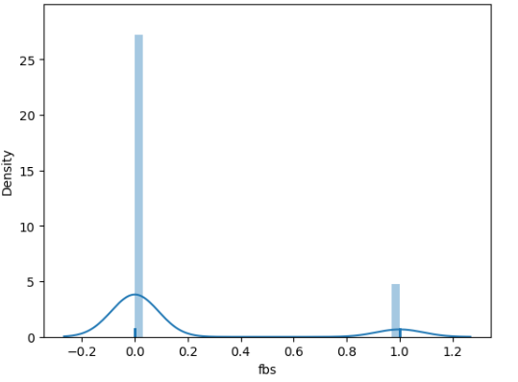
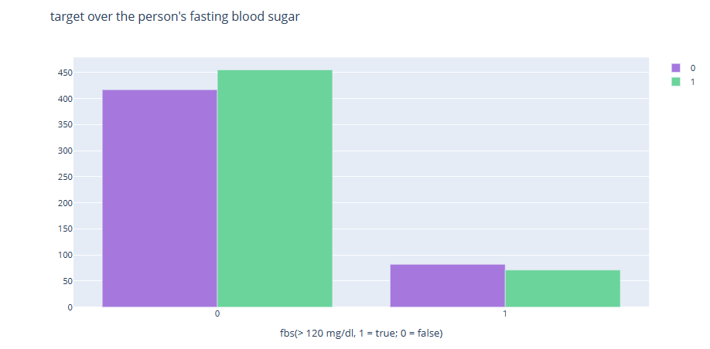
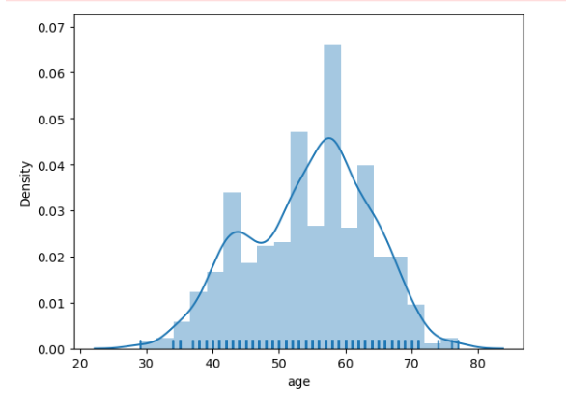
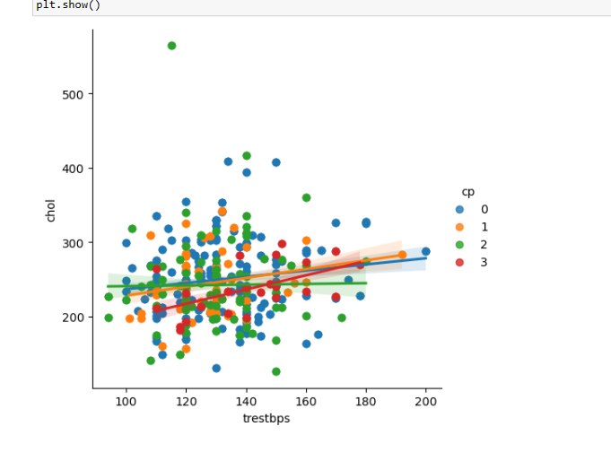

Slide 14
Feature Engineering
Dummy Variables
from the dataset 'cp', 'thal' and 'slope' are categorical variables we'll turn them into dummy variables.

Slide 15

MACHINE LEARNING MODELS
MODEL BULIDING

Slide 16
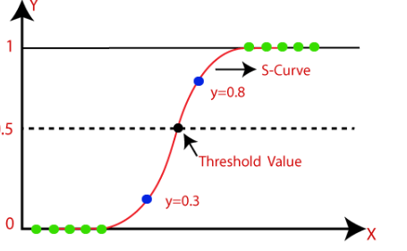
Logistic Regression
Library used : sklearn.linear_model (LogisticRegression)
P(Y=1|X) or P(Y=0|X)
Feature Scaling was performed after splitting the dataset to avoid information leakage on testing dataset by using Standardization method.
Accuracy : 79%
Recall : 0 - 74 %, 1 – 83 %
Precision : 0 – 82 %, 1 – 76%

Slide 17
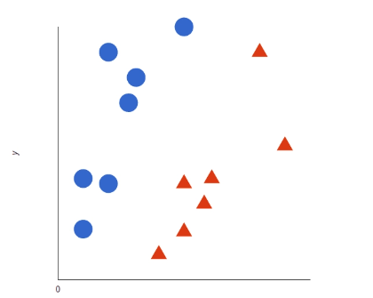
Support Vector Machine (SVM)
Library used : sklearn.svm (SVC)
SVM allows for more accurate machine learning because it’s multidimensional.
Feature Scaling was performed after splitting the dataset to avoid information leakage on testing dataset by using Standardization method.
Accuracy : 100%
Recall : 0 - 99 %, 1 – 100 %
Precision : 0 – 100 %, 1 – 99 %

Slide 18
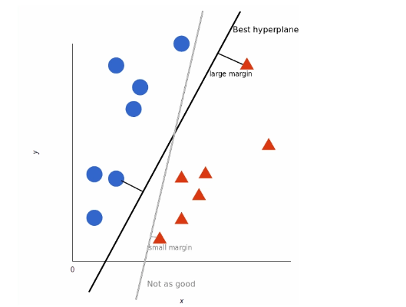
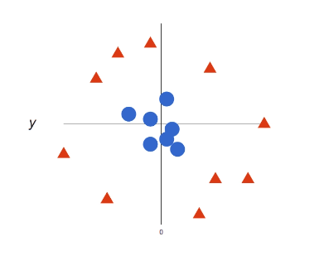
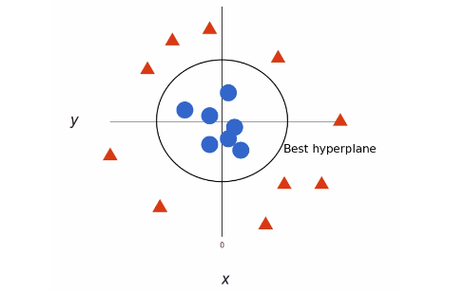
Support Vector Machine (SVM)

Slide 19
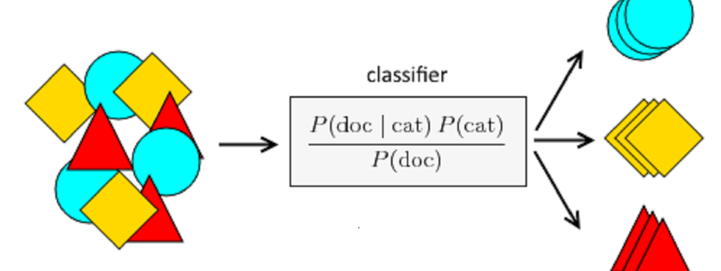
Naive bayes Classification

Slide 20
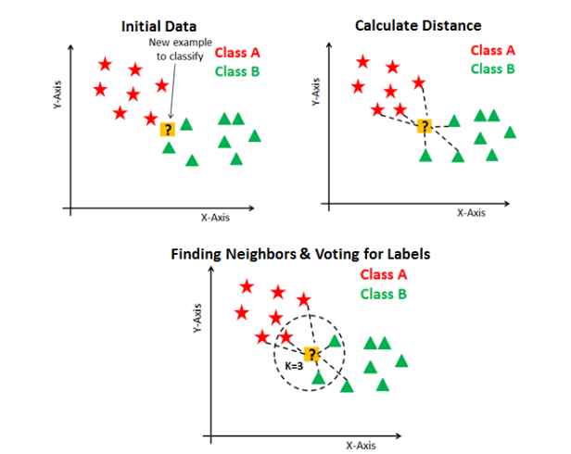
K - Nearest Neighbour
Library used : sklearn.neighbors (KNeighborsClassifier)
Split used for training and testing the data : 70-30
Feature Scaling was performed after splitting the dataset to avoid information leakage on testing dataset by using Standardization method.
Accuracy : 97%
Recall : 0 - 95 %, 1 – 100 %
Precision : 0 – 100 %, 1 – 95 %

Slide 21
Decision Tree
Library used : sklearn.tree (DecisionTreeClassifier)
Split used for training and testing the data : 70-30
Feature Scaling was performed after splitting the dataset to avoid information leakage on testing dataset by using Standardization method.
Accuracy : 97%
Recall : 0 - 95 %, 1 – 100 %
Precision : 0 – 100 %, 1 – 95%

Slide 22
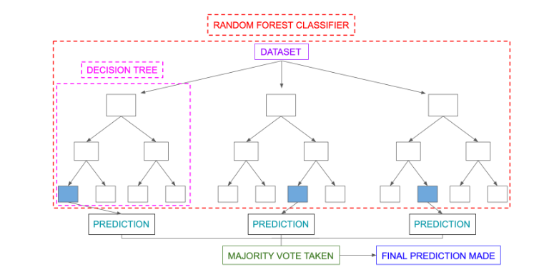
Random Forest

Slide 23
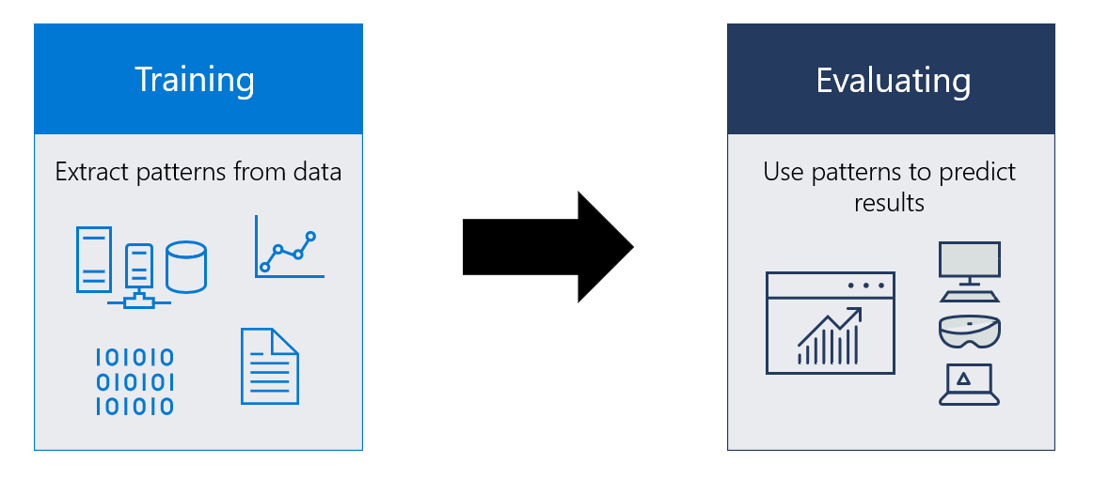
Creating Different Machine Learning Model

Slide 24
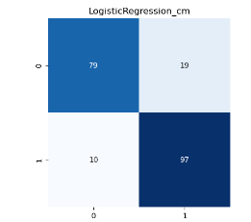
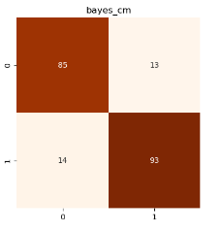
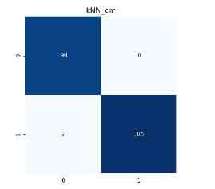
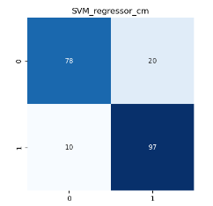
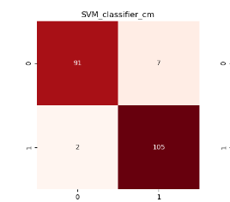
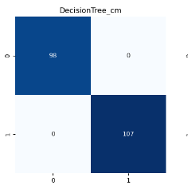
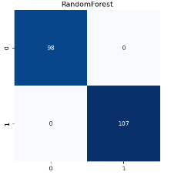

Slide 25
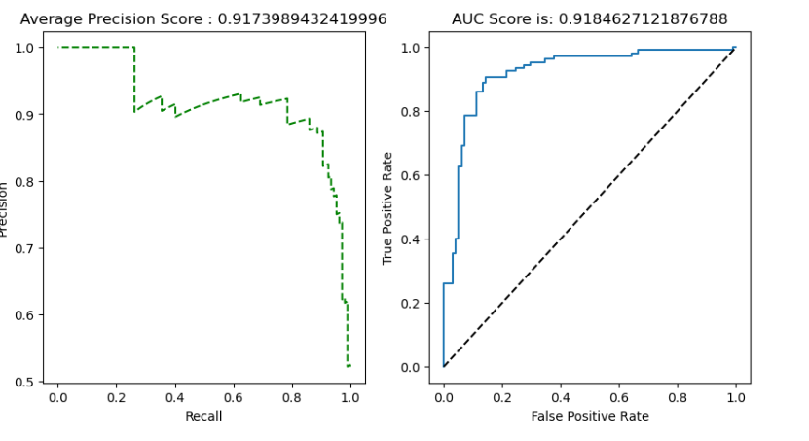
Accuracy Comparison

Slide 26
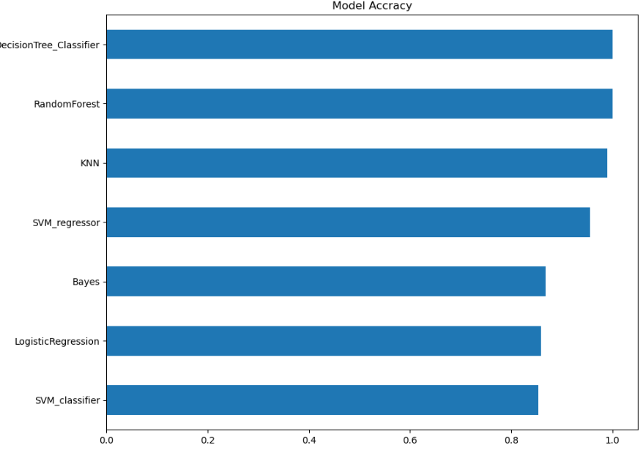
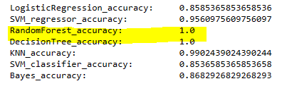
Model Accuracy

Slide 27


Slide 28


